Slide 1
Consciousness

Slide 2
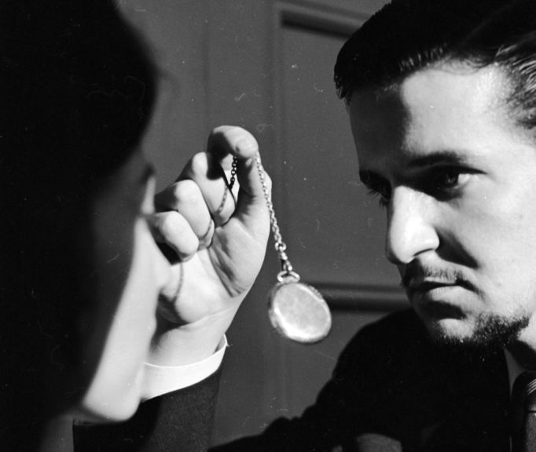
III. Hypnosis
HYPNOSIS MYTHS
• People in hypnosis lose control & can be made to say or do whatever the hypnotist wants.
• People may not be able to come out of hypnosis.
• Hypnosis only affects weak-willed people.
• Hypnosis enhances the accuracy of memory.
• Hypnosis enables people to re-experience a past life.
HYPNOSIS
1. Altered state of consciousness in which people become deeply relaxed & highly suggestible to changes in behaviors
Notes:
Hypnosis Myths (students don’t copy)- Before we talk about what hypnosis is. Let’s talk about what it isn’t. Here are some Hypnosis myths.
• People in hypnosis lose control & can be made to say or do whatever the hypnotist wants.
• People may not be able to come out of hypnosis.
• Hypnosis only affects weak-willed people.
• Hypnosis enhances the accuracy of memory.
• Hypnosis enables people to re-experience a past life.
Click for definition of Hypnosis: Hypnosis is an Altered state of consciousness in which people become deeply relaxed & highly suggestible to changes in behaviors

Slide 3
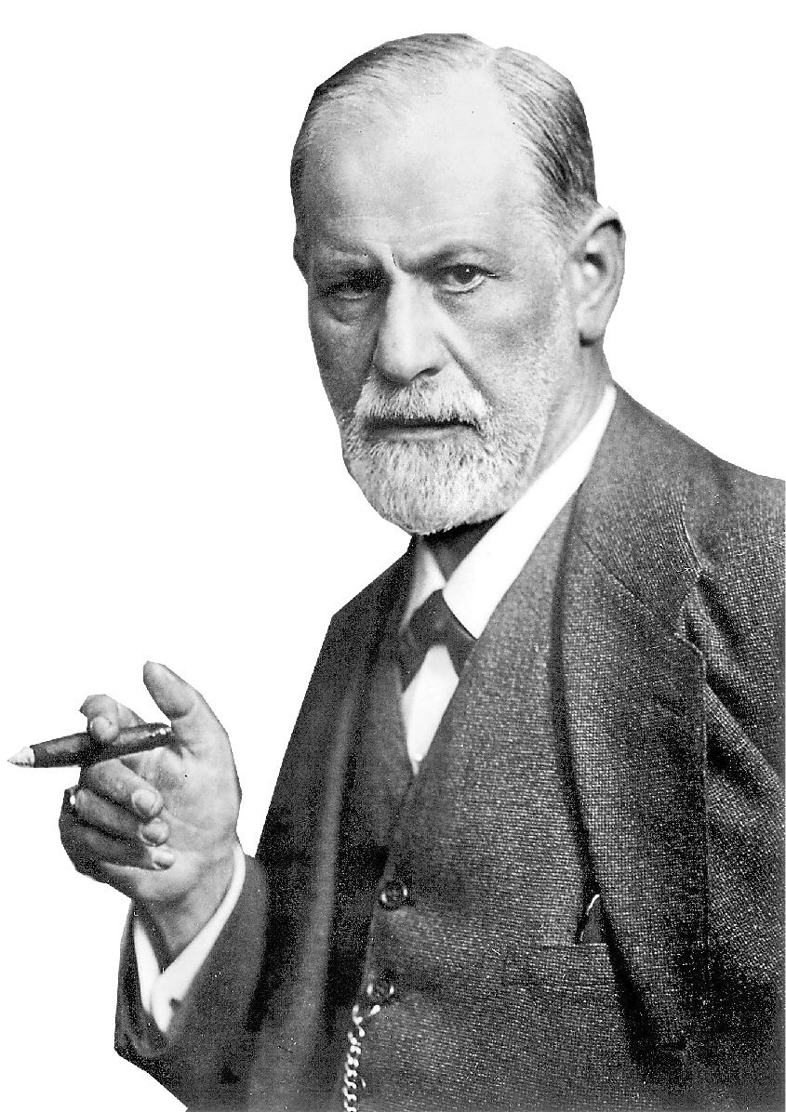
III. Hypnosis
Approach of Hypnosis
By Freud
Used hypnosis to:
• remove somatoform disorders
• access hidden memories from subconscious
Sigmund Freud
Notes:
Freud initially utilized hypnosis to help remove psychosomatic symptoms from patients who suffered from what we now call a somatoform disorder. These patients suffered from medical complaints like seizures, muscular spasms, and paralysis of their limbs that when examined, nothing physically, was wrong with them.
Freud learned that he could temporarily or permanently reduce many of these symptoms using hypnotic suggestions for the symptoms to be reversed. (e.g.,: “Your arm is calm again and will no longer spasm.”)
Freud also believed that Hypnosis allowed him access to memories within the patient’s unconscious mind which had been previously repressed.
Eventually, Freud began using free association instead of hypnosis as a way of accessing the unconscious.

Slide 4
III. Hypnosis
Approaches of Hypnosis
1. Divided Mind Approach Dissociation consciousness is divided into 2 parts - each aware
2. Social Influence Theory
Role Theory – people play a role like the behaviors of a hypnotized person
Response Expectancy Theory hypnotic suggestions alter expectations(Placebos)
Hypnosis Uses
Pain Control – birth, chemotherapy, dental
Treatment Therapy – headaches, smoking, weight control, nail biting
Notes:
Divided Mind Approach A researcher named Ernest Hilgard believed hypnosis involves a special dual- processing state of dissociation—a split between different levels of consciousness. Hilgard viewed hypnotic dissociation as a form of everyday mind splits—similar to doodling while listening to a lecture or typing the end of a sentence while starting a conversation.
For example, Hilgard felt that when hypnotized people lower their arm into an ice bath, the hypnosis dissociates the sensation of the pain stimulus (of which the subjects are still aware) from the emotional suffering that defines their experience of pain.The ice water therefore feels cold—very cold—but not painful.
Social Influence Theory: The Social Influence Theory is not a single theory, it is a combination of many social psychology theories that explains why people why people behave and feel the way they do during a hypnotic trance. According to role theory, people who are hypnotized are playing a part as if they are in a play. However, unlike actors in a play, hypnotized people may believe that what they are doing is real. Research has shown that many people in hypnotic traces may NOT be faking it. Rather, they become engrossed in playing the part of a hypnotized person. They use their imaginations to try to experience what the hypnotists tells them to experience. If they are told that they are blind, for example, and then are handed a book, they may think of a white curtain coming down over the page. Then they see or read anything. People with vivid imaginations are especially suggestible.
CLICK for Video

Slide 5
III. Hypnosis
Approaches of Hypnosis
1. Divided Mind Approach Dissociation consciousness is divided into 2 parts - each aware
Approaches
2. Social Influence Theory
Role Theory – people play a role like the behaviors of a hypnotized person
Response Expectancy Theory hypnotic suggestions alter expectations(Placebos)
Hypnosis Uses
Pain Control – birth, chemotherapy, dental
Treatment Therapy – headaches, smoking, weight control, nail biting
Notes:
Divided Mind Approach A researcher named Ernest Hilgard believed hypnosis involves a special dual- processing state of dissociation—a split between different levels of consciousness. Hilgard viewed hypnotic dissociation as a form of everyday mind splits—similar to doodling while listening to a lecture or typing the end of a sentence while starting a conversation.
For example, Hilgard felt that when hypnotized people lower their arm into an ice bath, the hypnosis dissociates the sensation of the pain stimulus (of which the subjects are still aware) from the emotional suffering that defines their experience of pain.The ice water therefore feels cold—very cold—but not painful.
Social Influence Theory: The Social Influence Theory is not a single theory, it is a combination of many social psychology theories that explains why people why people behave and feel the way they do during a hypnotic trance. According to role theory, people who are hypnotized are playing a part as if they are in a play. However, unlike actors in a play, hypnotized people may believe that what they are doing is real. Research has shown that many people in hypnotic traces may NOT be faking it. Rather, they become engrossed in playing the part of a hypnotized person. They use their imaginations to try to experience what the hypnotists tells them to experience. If they are told that they are blind, for example, and then are handed a book, they may think of a white curtain coming down over the page. Then they see or read anything. People with vivid imaginations are especially suggestible.

Slide 6
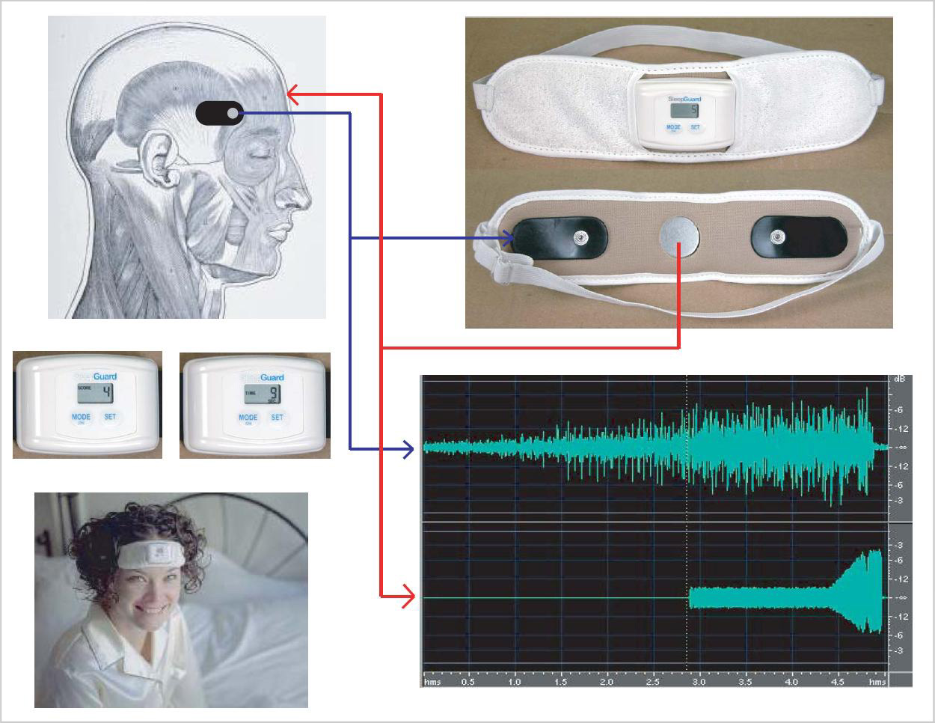
IIv. BioFeedback & Meditation
1. Biofeedback
process of learning to control bodily states w/the help of machines monitoring the states to be controlled
- Effects: rids people of tension headaches
Notes:
Biofeedback
Biofeedback is a system that provides, or “feeds back,” information about something happening in the body. Through biofeedback training, people have learned to control certain bodily functions, such as heart rate.
During a biofeedback session, electrodes are attached to your skin. Finger sensors can also be used. These electrodes/sensors send signals to a monitor, which displays a sound, flash of light, or image that represents your heart and breathing rate, blood pressure, skin temperature, sweating, or muscle activity.
Using biofeedback, people has learn not only to treat tension headaches, but also to lower their heart rates or blood pressure. However, with all treatments, biofeedback should be attempted only under the direct supervision of a medici professional.

Slide 7
IIv. BioFeedback & Meditation
2. Meditation
the focusing of attention to clear one’'s mind and produce relaxation
- Effects: lowers blood pressure, heart rate & respiration
Notes:
Meditation
Meditation is a method some people use to try to narrow their consciousness so that the stresses of the outside world fade away. Numerous techniques have been used to accomplish this. The yogis of India stare at an intricate pattern on a vase or carpet. Other meditators repeat pleasing sounds called mantras, such as oom or sheeereem and mentally focus on these sounds.
Al of these methods of meditation share a common thread - they focus on a peaceful, repetitive stimulus. This focus helps people narrow their consciousness and become relaxed. By narrowing their consciousness, people can suspend planning, worrying, and other concerns. Meditation is an important part of some religions, such as Buddhism. Some meditators claim that meditation helps them achieve “oneness with the universe,” pleasure or some great insight. These claims have never been scientifically proven, but evidence does suggest that meditation can help people relax. A study led by Heart Benson, for example, found that meditation can help people lower blood pressure, heart rate and respiration rate.

